Slide 1
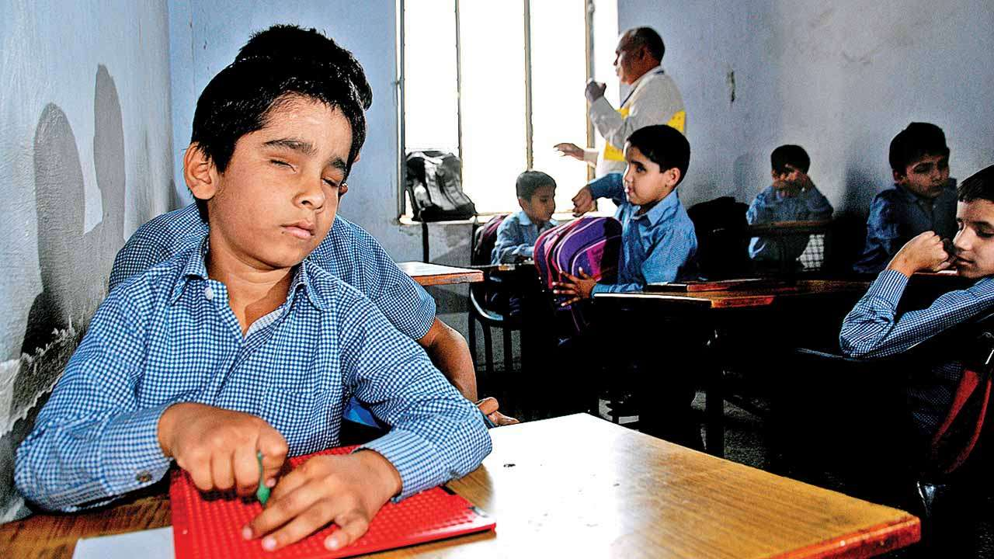

Braille Educational Toy
DES633: Integrated Product Development-I
Designed by Group 7

Slide 2
Table of Contents
01
introduction
04
Primary research
02
Visual impairment scenario
05
Product and USP
03
Product competition
06
Segmentation

Slide 3
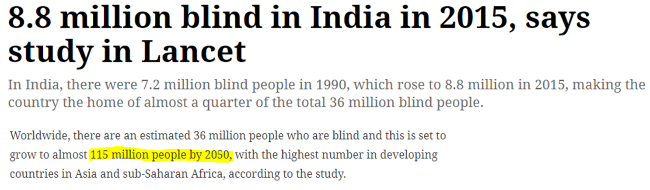
Introduction
According to reliable sources there are more than 8.8 million visually impared population as of 2015. An estimated study of 1995 shows that at least 200,000 children in india suffered severe blindness and only 7.5% made it to blind schools. These numbers has increased with time, many efforts have been made to support their education, we here come up with one such easy and cost effective solution.

Slide 4
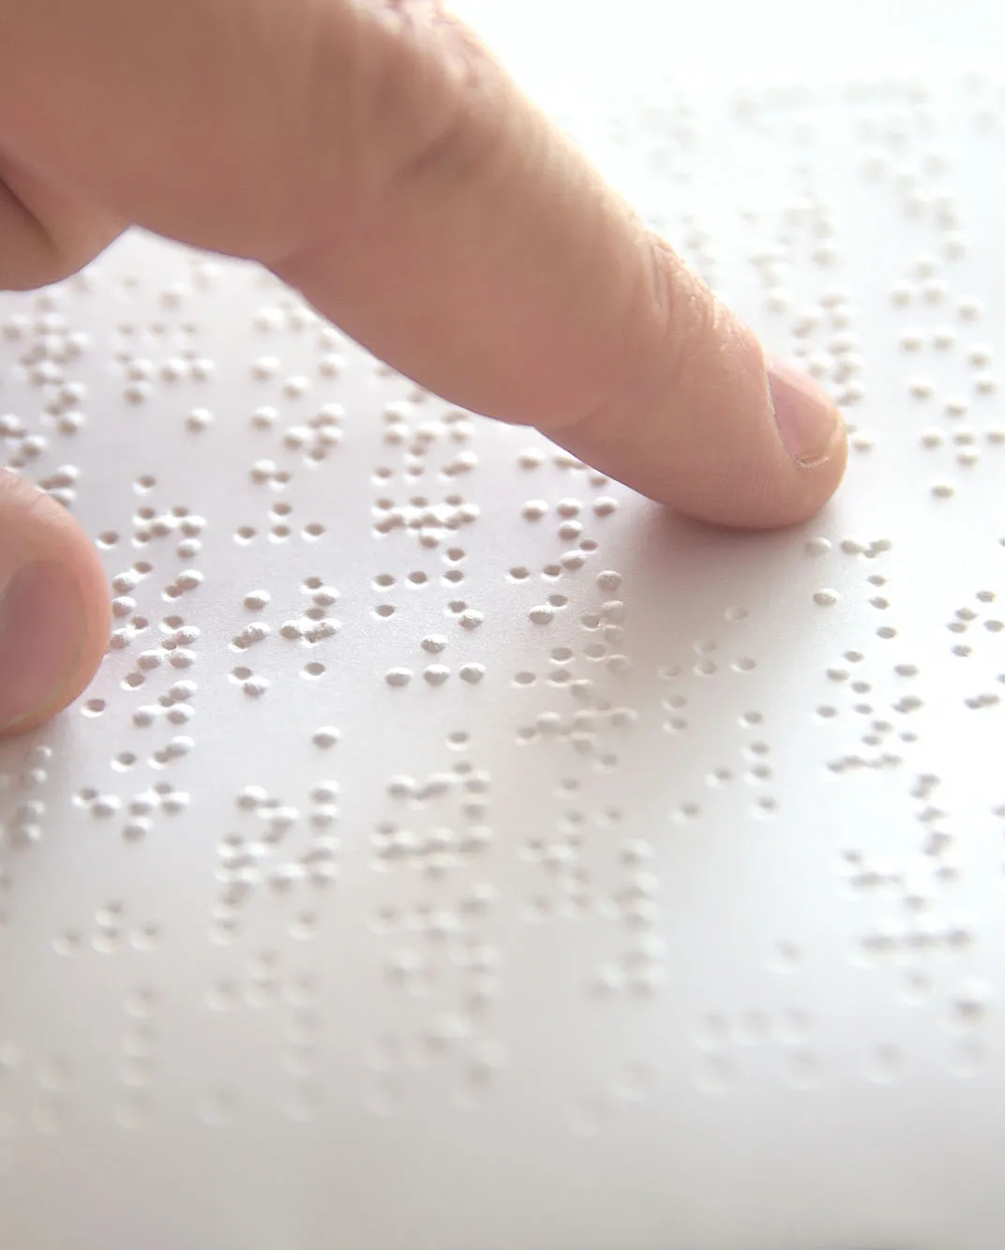
What is Braille?
Identifying Problem
Braille is a system of writing used by and for blind people and consisting of a code of 63 characters, each made up of one to six raised dots arranged in a six-position matrix or cell. These Braille characters are embossed in lines on paper and read by passing the fingers lightly over the manuscript.
the braille literacy rate there is only 1%, far lower than the regular literacy rate of 77.7%. This presents a significant problem; without braille education, the quality of life for visually impaired people is significantly decreased

Slide 5
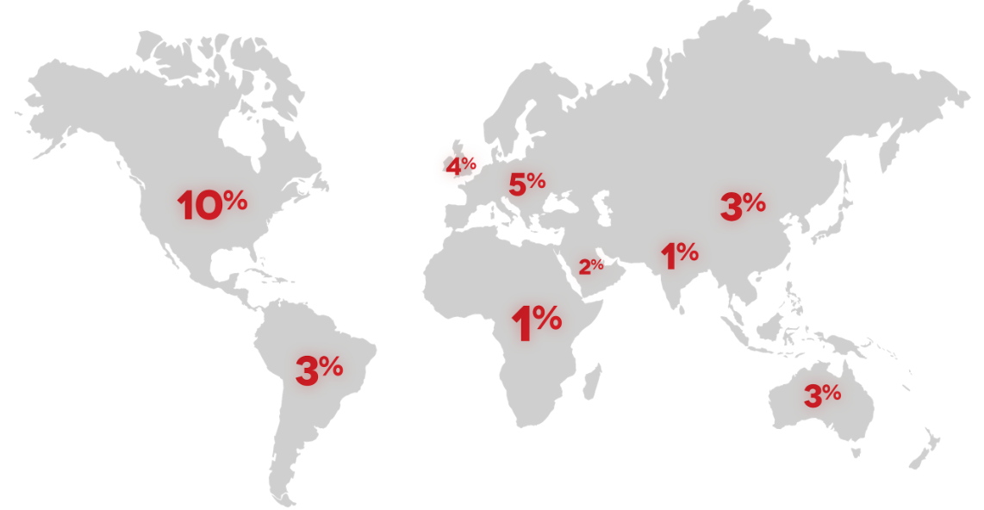
Visual Impairment Scenario
– in India
India is home of half of the world blind population
TOTAL - 106.34 Lakhs
(1.03% of Total Population)
Urban - 27.61 Lakhs
Rural - 78.73 Lakhs
Male : 57.32 Lakhs
Female : 49.02 Lakhs
https://www.thinkerbelllabs.com/need
darpg.gov.in› sites › default › files › EBraille.ppt

Slide 6
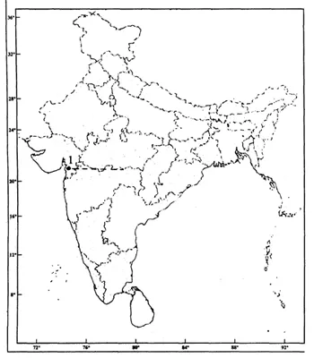

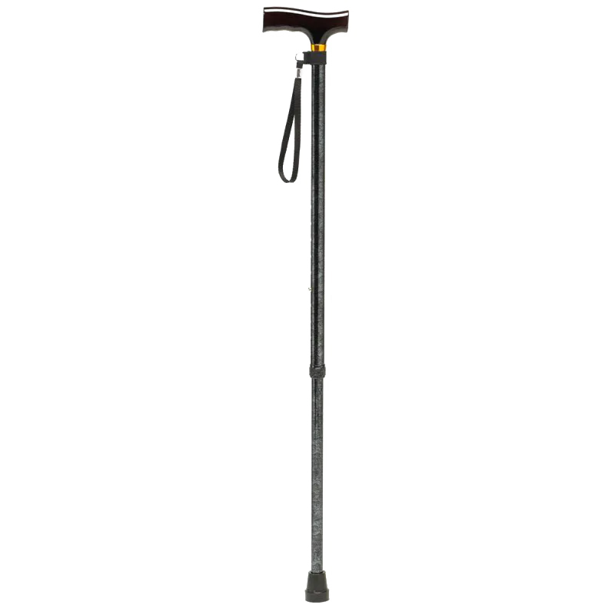
Visual Impairment Scenario
– State Wise In Lakhs
Delhi : 1.20 (0.87%)
U P : 18.52 (1.11%)
M P : 6.36 (1.05%)
Chhat’garh: 1.60 (0.77%)
Bihar : 10.05 (1.21%)
Jharkhand: 1.86 (0.69%)
W B : 8.62 (1.07%)
Orissa : 5.13 (1.39%)
Assam : 2.82 (1.06%)
Tamilnadu: 9.63 (1.54%)
A P : 5.82 (0.76%)
Karnataka: 4.41(0.83%)
Kerala : 3.35 (1.05%)
Maharastra: 5.81(0.60%)
Rajasthan: 7.53 (1.33%)
Gujarat : 4.94 (0.97%)
Punjab : 1.70 (0.70%)
Haryana : 2.01 (0.95%)
J&K : 2.08 (2.05%)
Source: Census 2001
darpg.gov.in› sites › default › files › EBraille.ppt

Slide 7
Visual Impairment Scenario
•Prevalence in Rural Areas and among Economically Weaker Section.
•Due to financial condition it is often difficult for the families to provide necessary support for development of skills for the persons.
•Employment – 1% reserved for people with blindness / low vision
•Education
- learning material
- Non-formal education, where necessary
•Development and research for
- Affordable Aids and Appliances
- Special education
Source: Census 2001
darpg.gov.in› sites › default › files › EBraille.ppt

Slide 8
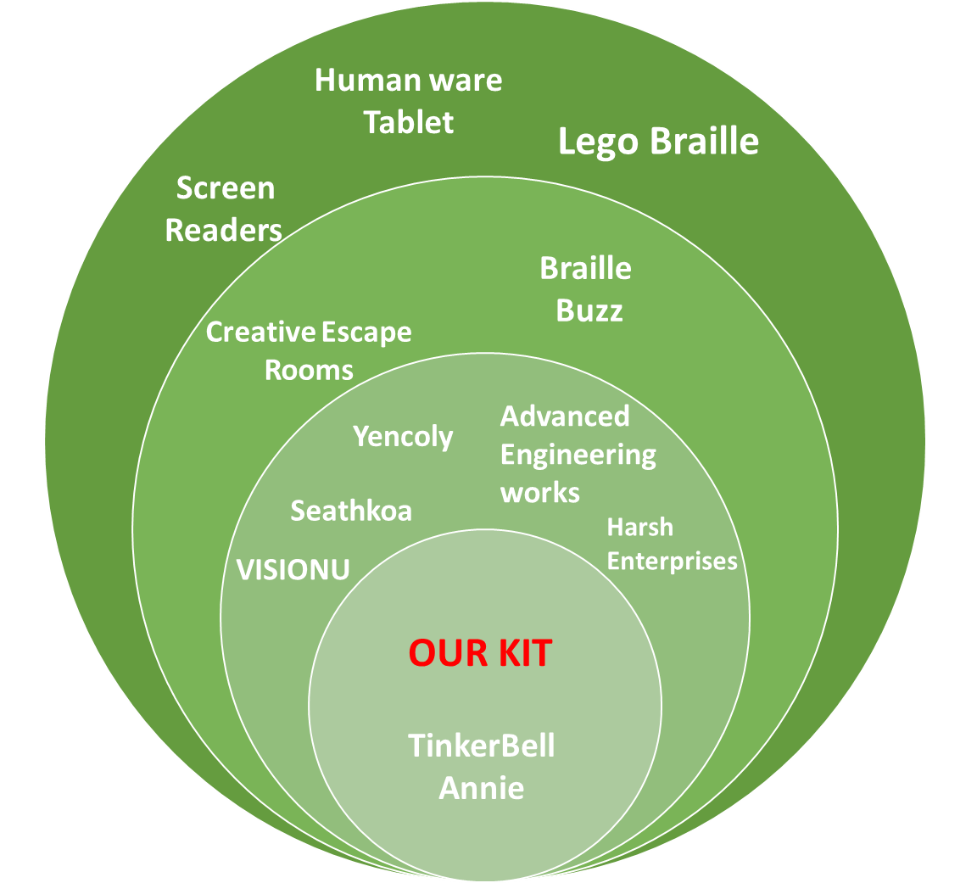
PRODUCT COMPETITION
Market definition
Grouping some of the competitors of the braille kit in the market.

Slide 9
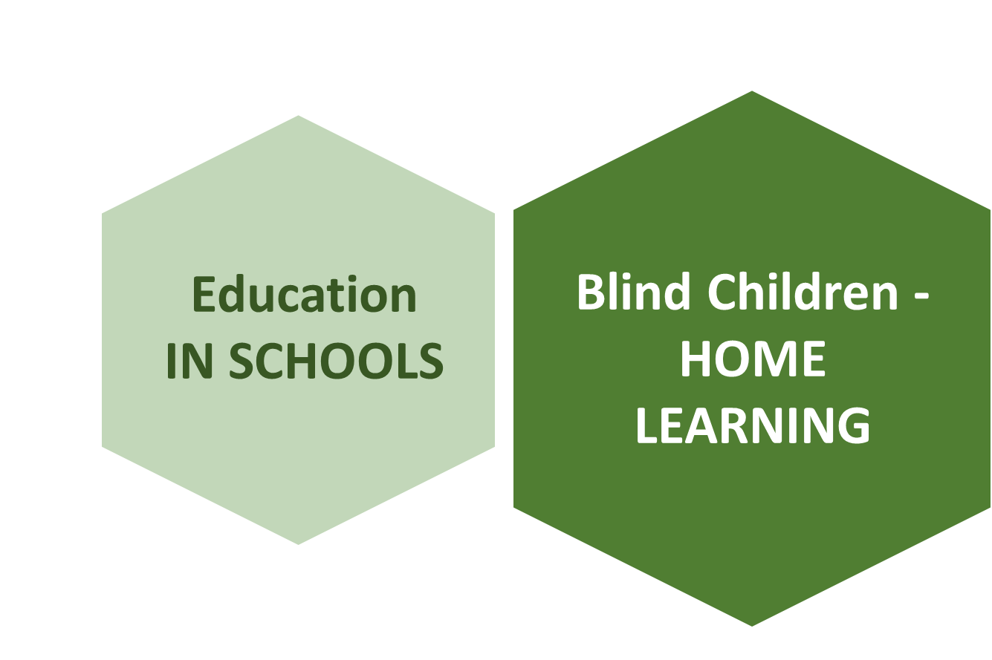
TYPES OF CUSTOMER
Market definition
Based on the broad basis of the type of the customers,
We are aiming to define our market mainly on the Blind kids who learn to read and write braille in schools.

Slide 10
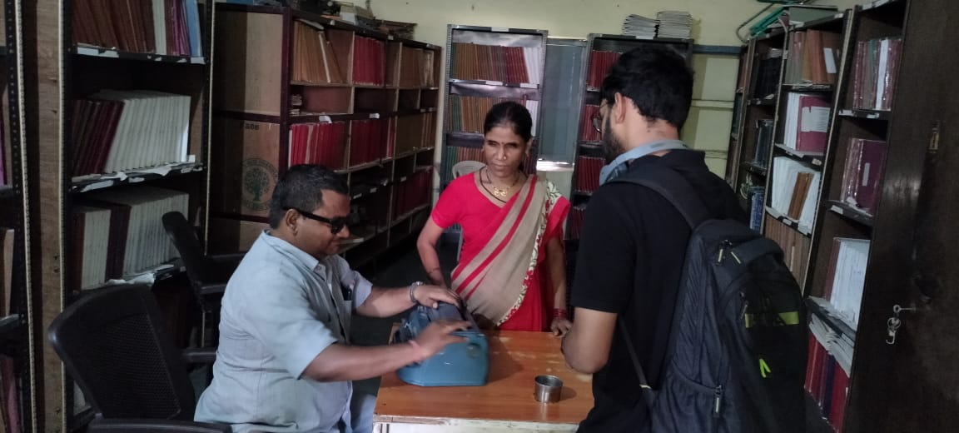
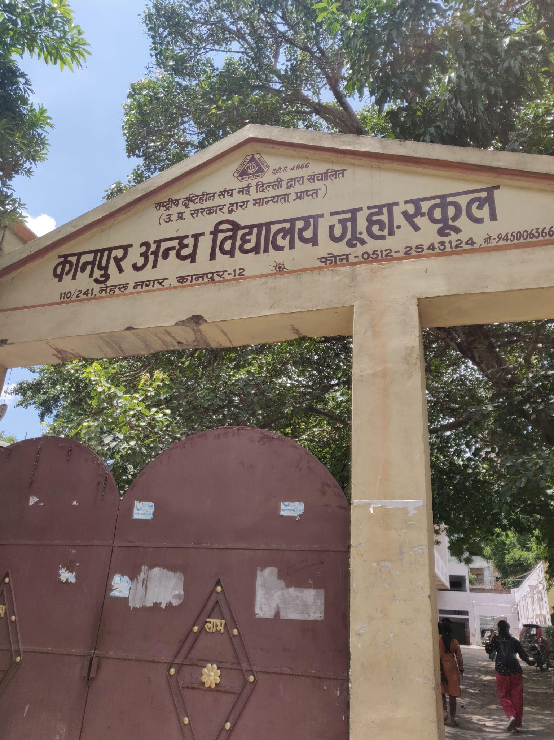
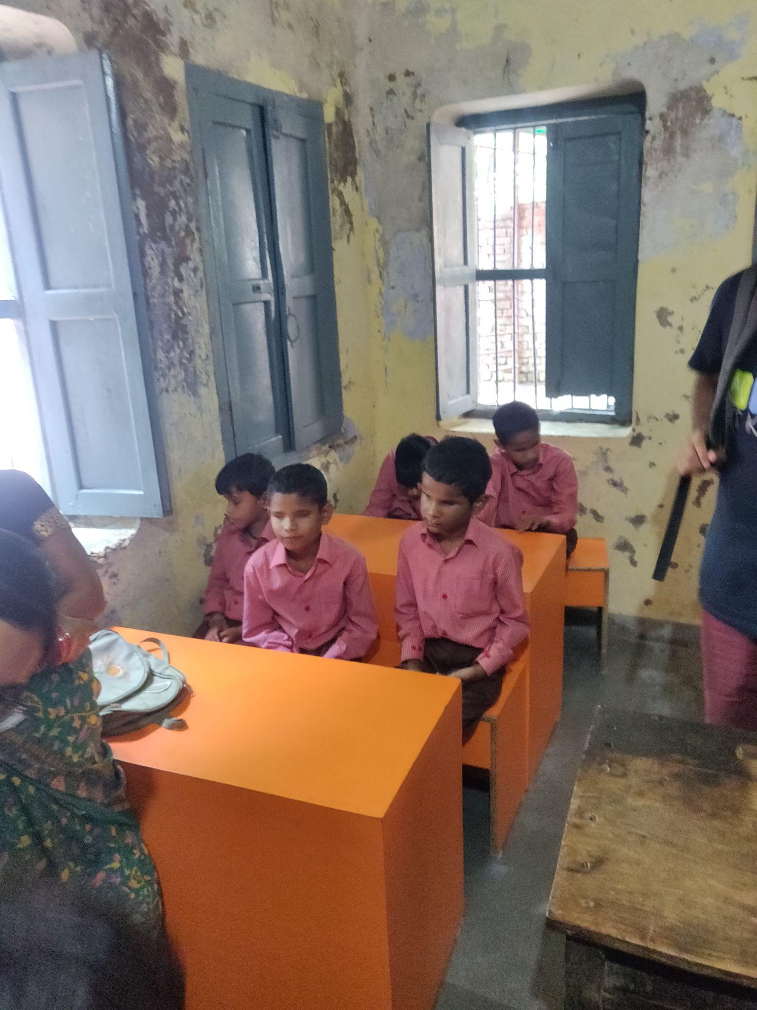
MARKET RESEARCH
Primary Research
Visit to Kanpur Andhvidhyalaya

Slide 11
MARKET RESEARCH
Primary Research
Key Takeaways
Meeting them in person enabled us to empathise with them and understand their problems better
Without braille literacy, blind people are often unable to understand or use written communication. As a result, they require an interpreter to read and write for them
Braille education is an important step to empower the visually impaired. Knowing braille gives them sense of pride, a feeling of being independent.
The method of teaching is not advanced. Same old techniques are in use. it takes one student one full year to learn the basics of braille with constant teacher supervision, outdated teaching methods and unmotivating content.
There is shortage of teachers who can provide the necessary education to blind students.
Got to know from which class kids start to learn braille and
Most of the students come from rural areas where the poverty rate is high.
Those in poverty bear the brunt of the negative effects of blindness as they cannot afford costly educational products.
More needs to be done to bring braille education to the 15 million blind people in India.

Slide 12
PROFIT AND MARKET SHARE
How much they willing to pay(P) : Rs. 240 to 300
How many such people are available to pay(N): approx. 1250( in Kanpur)
Market share(X): 30%
Revenue: PNX
Cost of Toy: Rs.150-180
Profit: (P-C)NX = (270-165)x1250x0.3 = Rs.39375

Slide 13
Our Product
Unique Selling Point
Learning braille is a skill that, like most, is best learned at an early age by those who need it. But toddlers with vision impairment often have few or no options to do so, leaving them behind their peers academically and socially. This is a toy created for early education of a blind kids and makes them comfortable and easy for parents facing the challenge to teaches the kids. Our product makes kids to learn braille in a fun and simple way. Kids can identify and learn easily by observing and listening the Toy.
Interactive
Easy to use
affordable

Slide 14
Segmentation
DEMOGRAPHICS
Population | 15 million | Children and adults suffering from blindness and moderate to severe visual impairment.
Household Income | > 2 Lakh | Middle class income households and above.
Occupation | Students | Primary users
 | Working class | Secondary users
Education level | Primary and above | They will either use the product to read and write or learn to read and write

Slide 15
Segmentation
GEOGRAPHIC
Region | India
Density | Urban
 | Rural
PSYCHOGRAPHIC
Attitude | Strivers

Slide 16
Resources
https://www.youtube.com/watch?v=M6mUNyj3WRM
https://www.youtube.com/watch?v=IMJeWOgiOtM
https://www.youtube.com/watch?v=Q2F5QQlbndc
https://indianexpress.com/article/india/8-8-million-blind-in-india-in-2015-says-study-in-lancet-4781368/
https://news.microsoft.com/on-the-issues/2019/08/08/smart-tech-blind-low-vision/
https://www.ncbi.nlm.nih.gov/pmc/articles/PMC1706015/#:~:text=There%20are%20about%201.5%20million,two%20years%20of%20becoming%20blind.
https://pubmed.ncbi.nlm.nih.gov/8543070/#:~:text=It%20is%20estimated%20that%20at,in%20schools%20for%20the%20blind.
https://www.researchgate.net/publication/257714228_Slate_and_Stylus_An_Alternative_Tool_for_Braille_Writing

Slide 17
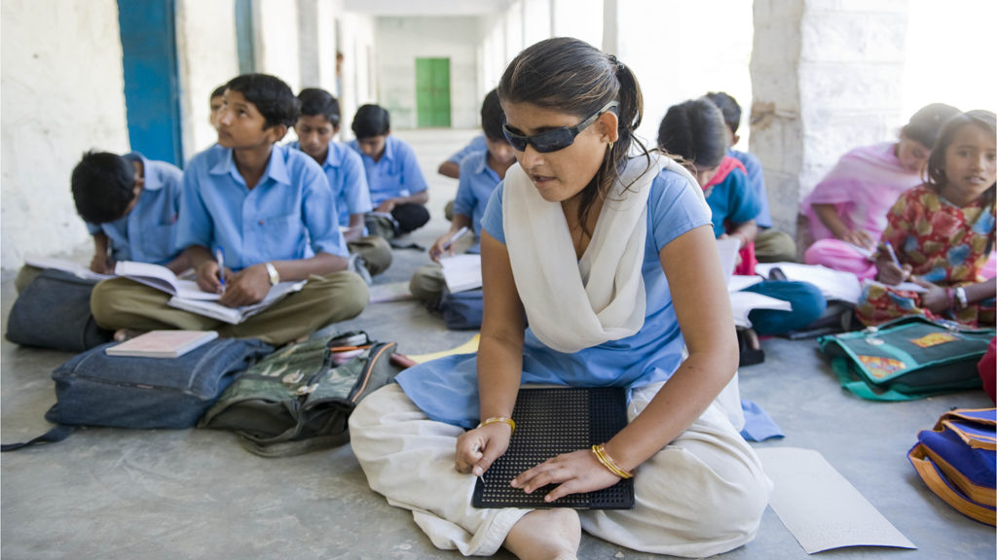
THANK YOU!

